Slide 1
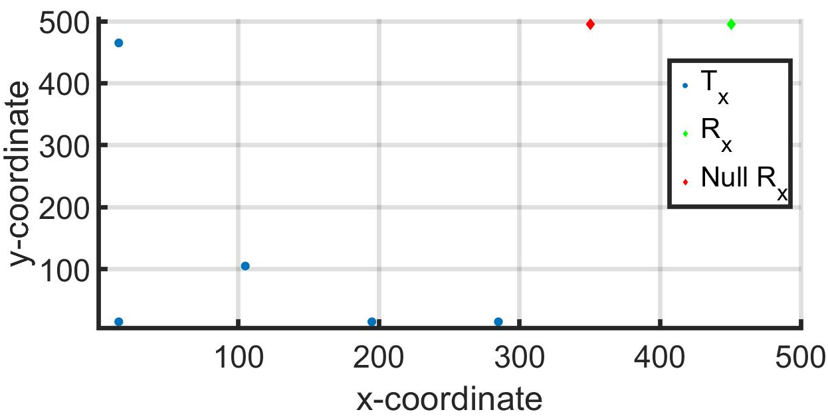
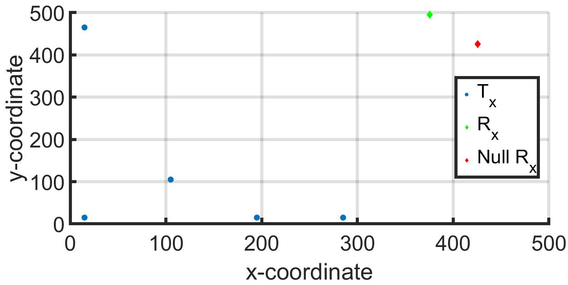
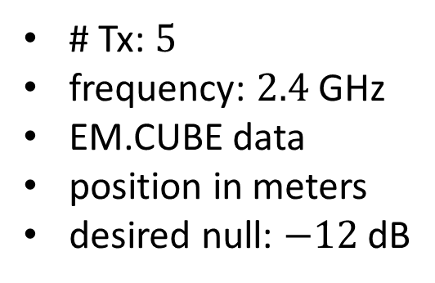
(x,y)-Position of Agents and Receivers
true position of receivers
configuration 1
configuration 2
# Tx: $5$
frequency: $2.4$ GHz
EM.CUBE data
position in meters
desired null: $−12$ dB
each Tx has erroneous locations of Rx and null Rx
error in location generated i.i.d. from normal distribution of zero mean and 5 (which is approx. 1% of the true coordinates in meters) std

Slide 2
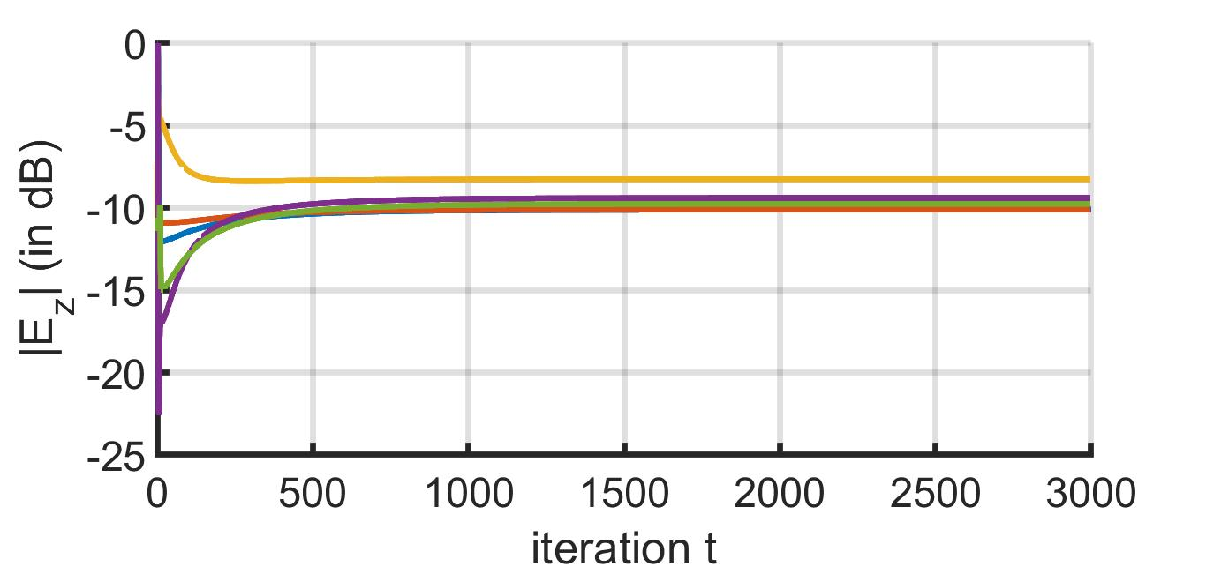
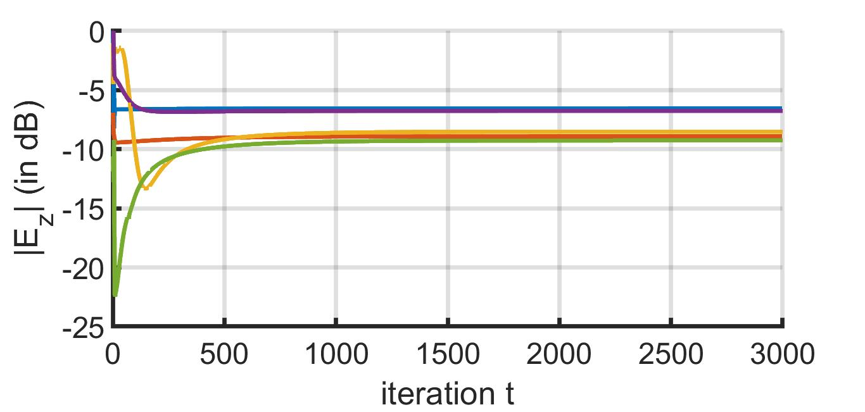
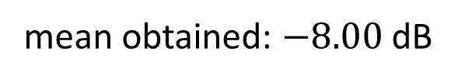
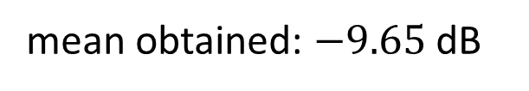
RSS at Adversary – Config. 1
exact Rx location known
erroneous Rx location known
mean obtained: $−9.65$ dB
mean obtained: $−8.00$ dB

Slide 3
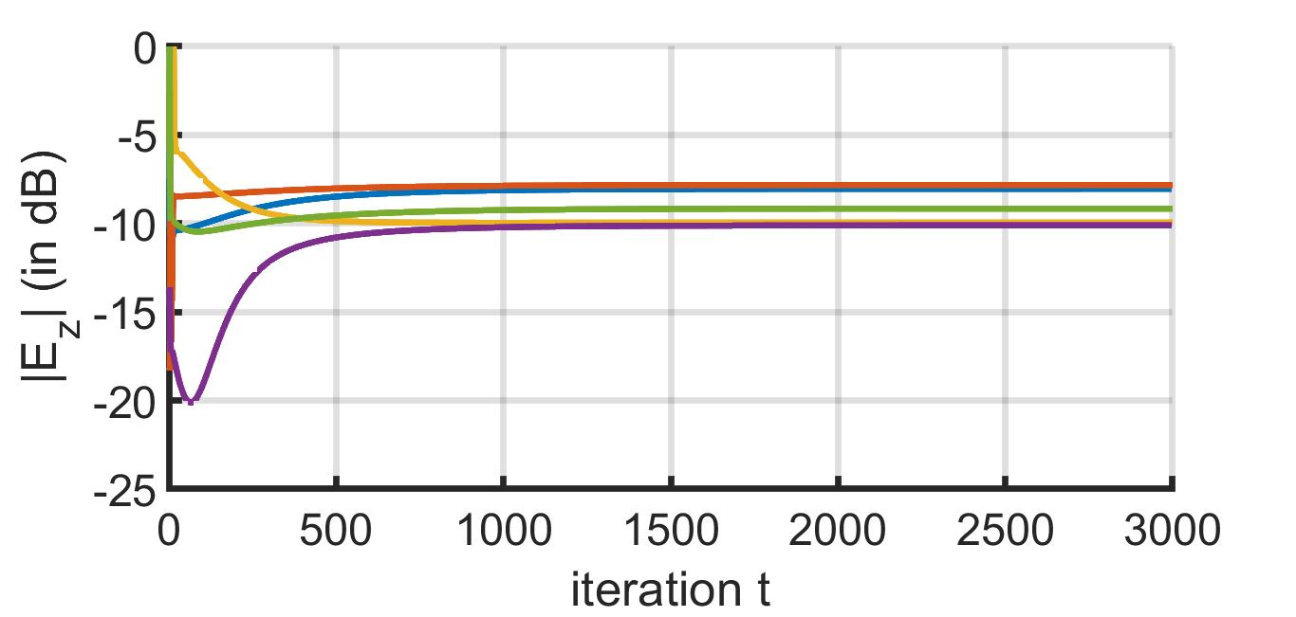
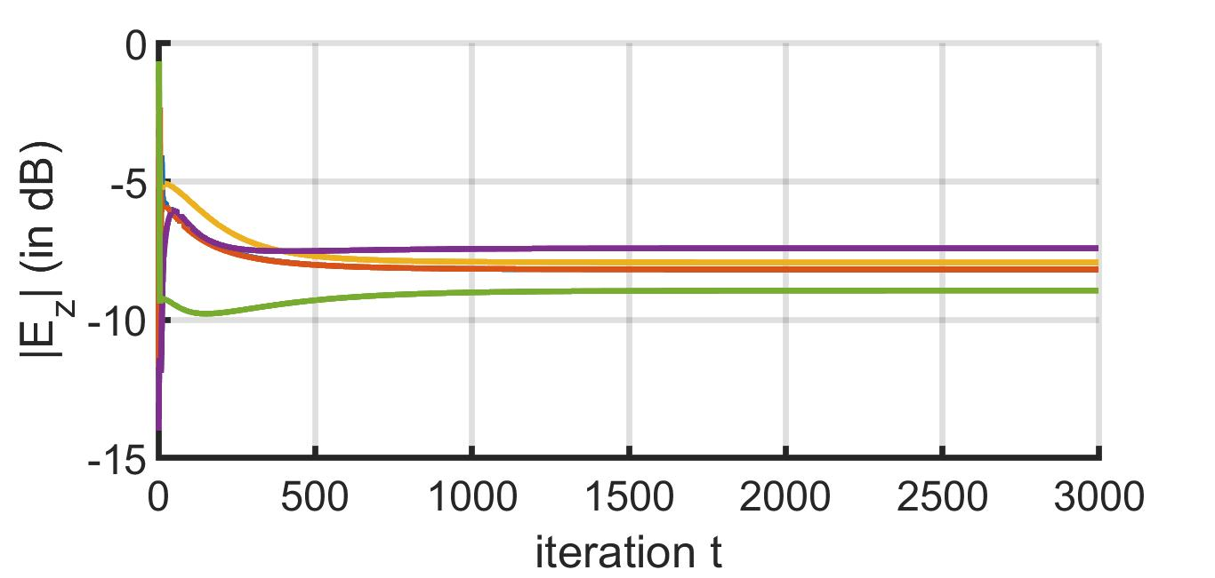
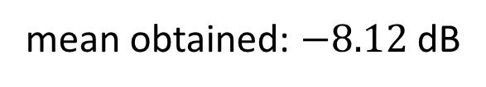
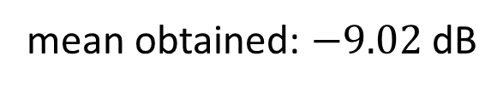
RSS at Adversary – Config. 2
exact Rx location known
erroneous Rx location known
mean obtained: $−9.02$ dB
mean obtained: $−8.12$ dB

